Slide 1

Interactive Tutorial
BY JACK CAREY
CLICK TO START

Slide 2




OBJECTIVE
Your mission is to pilot the Vic Viper, a prototype space fighter, into enemy space and destroy the invaders of the planet Gradius.
You must avoid enemy fire and destroy the hoards of alien spacecraft that relentlessly attack you using the Vic Viper’s sophisticated on-board armament.
Collect power-up capsules to upgrade your engine and weapon capacity. You are Gradius’ last hope! You must last as long as you can whilst achieving the highest score possible. Try and get the high score!
Press the right-facing arrow when you are ready to continue the tutorial.

Slide 3
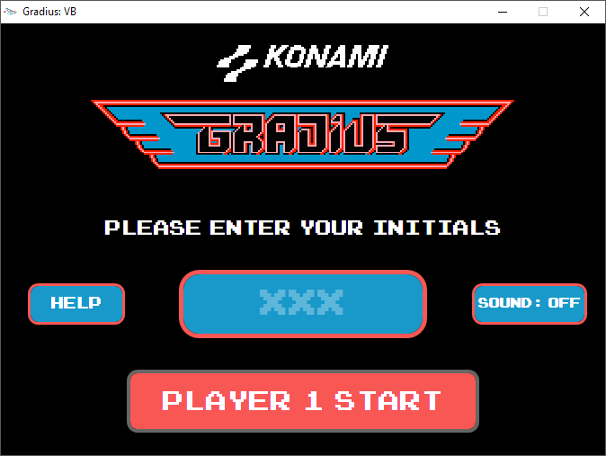
PLAYING THE GAME
Once you’ve opened the game, you will be presented with this screen.
Press the “Help” button for a help screen and this tutorial, and press the “Sound” button to toggle the sound effects for the game. If it says “OFF”, the sound is off, if it says “ON”, the sound is on.
Enter your initials in the text box, ensuring they are three capital letters, for example “JSC” and press the start button!
Press the start button when you are ready to move on.
TIP: Try pressing the sound button now.

Slide 4
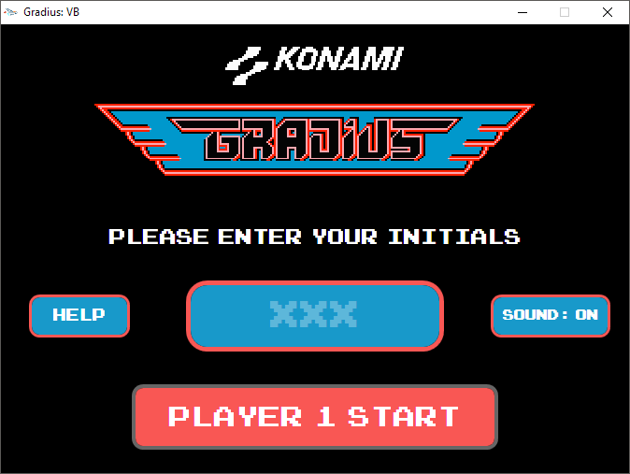
PLAYING THE GAME
Once you’ve opened the game, you will be presented with this screen.
Press the “Help” button for a help screen and this tutorial, and press the “Sound” button to toggle the sound effects for the game. If it says “OFF”, the sound is off, if it says “ON”, the sound is on.
Enter your initials in the text box, ensuring they are three capital letters, for example “JSC” and press the start button!
Press the start button when you are ready to move on.
TIP: Try pressing the sound button now.

Slide 5
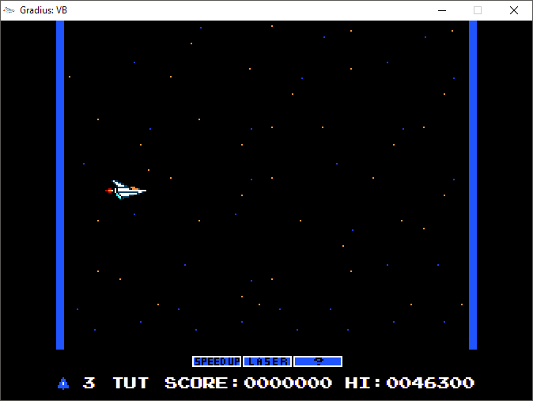
INTERFACE
The game screen where gameplay will take place. Enemies and terrain will appear here.
Click to close the game at any time
Once the game has started, this is the view you will be presented with.
The different elements of the game is labelled to the right. Click the arrow when you are ready to continue.
The Vic Viper. This is the ship you are controlling.
The power meter, displays current powerups.
Your remaining lives
Your name
Your current score
The current highest score

Slide 6



CONTROLS
UP
To move the Vic Viper, use the arrow keys. Avoid oncoming enemies and the variety of mountains and terrain, otherwise you’ll crash!
LEFT
RIGHT
DOWN
To fire the Vic Viper’s weapons, press the A key. To activate the selected power-up, press the S key. Try clicking the A button to see the Vic Viper fire! Click the arrow to continue.
FIRE
POWER-UP

Slide 7
POWER-UPS
The power meter includes three power-ups:
Speed Up: increase the movement speed of the Vic Viper
Laser: Upgrade your weapons to fast travelling, enemy piercing lasers
?: Upgrade your weapons to a rapid-fire mode, where you can fire as quickly as you want to.
You can activate Speed Up as many times as you want, however be careful! The Vic Viper may become uncontrollable! You can only one of either Laser or ? active at once. Click the arrow to continue

Slide 8

POWER-UPS
Power Capsules spawn when you destroy an entire formation of enemies, or when you kill a red coloured enemy. When you collect a Power Capsule, the selected power-up on the power meter progresses up the list by one. This does NOT mean that the power up is active. To activate the highlighted power-up, press the S key and the power-up will be enabled. As an example, to enable laser, you need to collect 2 power ups and then press the S key to enable it.
Click the power-up on the right to see an example of how the power-meter progresses. Click the arrow to move on.

Slide 9
POWER-UPS
Power Capsules spawn when you destroy an entire formation of enemies, or when you kill a red coloured enemy. When you collect a Power Capsule, the selected power-up on the power meter progresses up the list by one. This does NOT mean that the power up is active. To activate the highlighted power-up, press the S key and the power-up will be enabled. As an example, to enable laser, you need to collect 2 power ups and then press the S key to enable it.
Click the power-up on the right to see an example of how the power-meter progresses. Click the arrow to move on.

Slide 10
POWER-UPS
Power Capsules spawn when you destroy an entire formation of enemies, or when you kill a red coloured enemy. When you collect a Power Capsule, the selected power-up on the power meter progresses up the list by one. This does NOT mean that the power up is active. To activate the highlighted power-up, press the S key and the power-up will be enabled. As an example, to enable laser, you need to collect 2 power ups and then press the S key to enable it.
Click the power-up on the right to see an example of how the power-meter progresses. Click the arrow to move on.

Slide 11
POWER-UPS
Power Capsules spawn when you destroy an entire formation of enemies, or when you kill a red coloured enemy. When you collect a Power Capsule, the selected power-up on the power meter progresses up the list by one. This does NOT mean that the power up is active. To activate the highlighted power-up, press the S key and the power-up will be enabled. As an example, to enable laser, you need to collect 2 power ups and then press the S key to enable it.
Click the power-up on the right to see an example of how the power-meter progresses. Click the arrow to move on.

Slide 12
SCORING
To get points, destroy enemies and collect power ups.
Enemy Kill: 100 Points
Power Capsule Pickup: 500 Points
As you advance through the game, enemies will gradually get faster and faster, making it more difficult for you to survive. You start with three lives, but how many points can you achieve before it gets too hard? Click the arrow to continue.

Slide 13
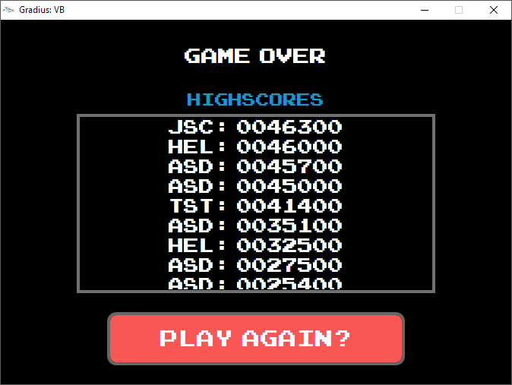
GAME OVER
Once you run out of lives and die a final time, the game is over. This screen will show you all the high scores which have been set on your computer. Try and reach the top spot! Press the button to restart the game. Press Escape on your keyboard to close the presentation and start the game!
Good luck and Godspeed, pilot!

